Slide 1
Time to Examine Your GST 03 and GAF

Slide 2
GST-03 Submission Guideline
Setup
Verify
Finalize
Submit
Notes:
4 simple steps to prepare and review your GST return before submission.
Setup
We will discuss about the 2 new enhancements, i.e. taxable period setup and security control in GST-03. This enhancement is meant to have better control on your GST-03 generation to avoid unnecessary error.
Verify
We will walk through with you how to cross check your GST-03 against the tax report and also GST input tax & output tax ledger/
For some companies, this coming submission is their 3rd submission. I believe we have learnt a lot during the previous 2 submissions. So, we would like to take this opportunity to share with you especially for those companies that will be doing 1st submission, what are some common mistakes made and how to rectify it.
Finalize
After we have reviewed the 3 reports and they are tally, we will need to save the GST-03 as a final copy.
I believe all of us here are good tax payers, and we make sure we do the GST submission on time. Sometimes, after submission, we discovered that we have made some mistake in the submission and would like to rectify it. According to JKDM, we are allowed to re-submit the GST return if we discover any mistake made and quickly rectify it before the GST due date. So, we will share with you how to re-generate the GST-03 for re-submission.
Submit
Finally, everything is ready. We can now submit the finalized GST Return to JKDM.
There are 2 ways of submission, i.e. online or manual.
We will share will you the steps to generate the files for both online submission and manual submission.

Slide 3
GST-03 Submission Guideline

Part 1 | Setup

Slide 4
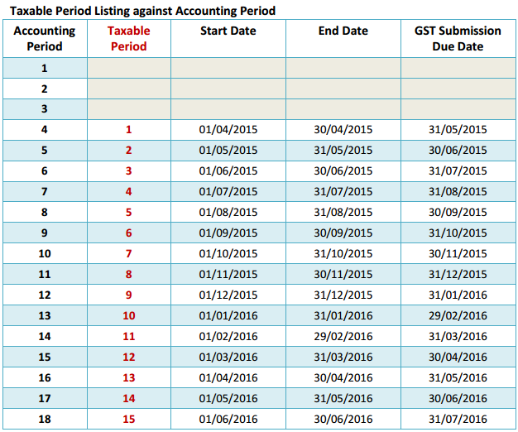
Part 1 | Setup Taxable period
Notes:
Every taxable person will be assigned a taxable period for which he is required to account for tax in his return to be furnished to the Director General.
In this enhancement, system will auto generate the taxable period based on your financial period.
In this 1st example, the taxable period is 1 month.

Slide 5
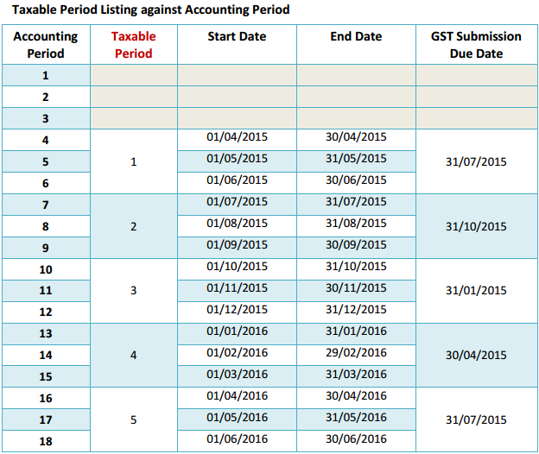
Part 1 | Setup Taxable period
Notes:
In this 2nd example, the taxable period is 3 months.

Slide 6
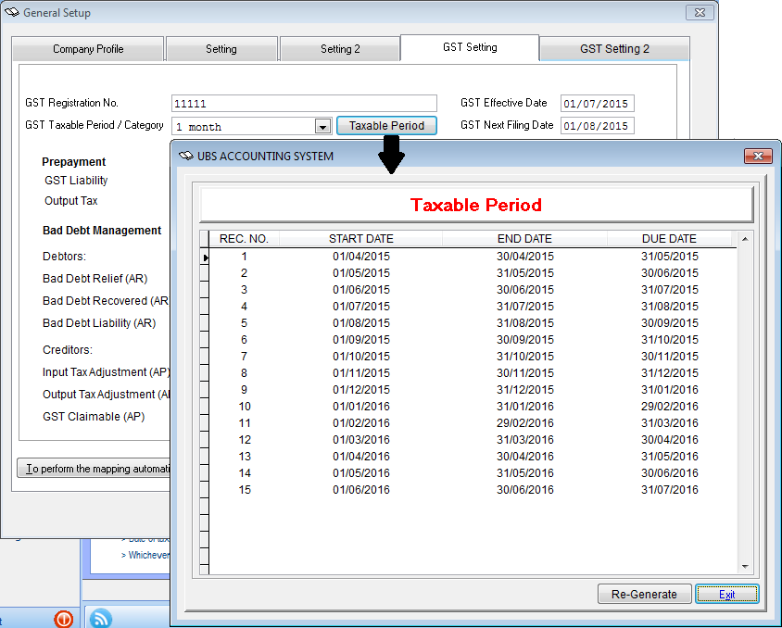
Part 1 | Setup Taxable period
Go to [Housekeeping > Setup > General setup]
The taxable period is generated automatically.
Notes:
You can view the taxable period generated in the GST setting, click on [Taxable period] button.

Slide 7
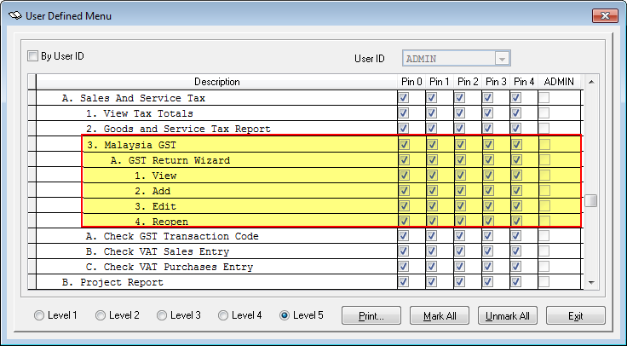
Part 1 | Setup GST-03 Access Rights
Housekeeping > Setup > User Defined > User Defined Menu
Notes:
GST-03 report is confidential data, we believe you prefer only authorized personal is able to generate, edit, even view the report.
With this consideration, we have implemented proper access rights for GST-03.
So, it is up to you to control who will be able to View, Generate, Edit & Re-generate the GST-03.

Slide 8
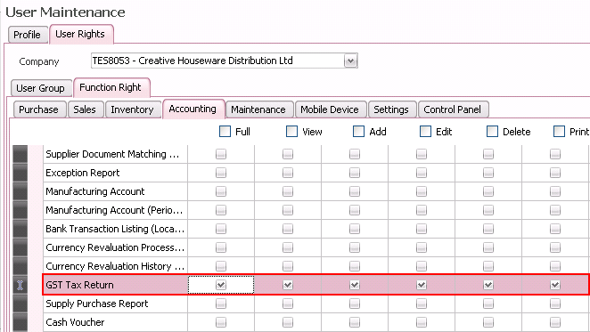
Part 1 | Setup GST-03 Access Rights
Control Panel > Administrative Tasks > Manage User

Slide 9
GST-03 Submission Guideline

Part 1 | Setup

Part 2 | Verify
Notes:
When you sign up to attend this workshop, you also participated in a survey on what is your most concern area.
Based on the survey result, your most concern topic is you would like to learn how and where to check your GST reports.
So, in this part, we will walk you through, how to check and verify your GST reports.

Slide 10
Part 2 | Verify Tax Report , Input/Output Tax GL Ledger, GST-03
Step 1:
Generate Goods & Service Tax report.
Generate ledger report for GST Input tax and GST Output tax GL.
Generate draft GST-03 of current taxable period
Notes:
Firstly,
Generate Goods & Service Tax report.
Generate ledger report for GST Input tax and GST Output tax GL.
Generate GST-03 of current taxable period, save is as Draft.

Slide 11
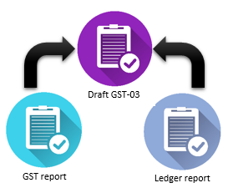
Part 2 | Verify Tax Report , Input/Output Tax GL Ledger, GST-03
Step 2:
Cross check the reports. Make sure they are tally.
Notes:
Secondly,
Cross check the reports. Make sure they are tally.
For example,
The amount in GST-03 5(b), should be the same as the balance of GST Output Tax GL; GST-03 6(b), should be the same as the balance of GST Input Tax GL.
The amount in GST-03 5(a) & 5(b), should be the same as total taxable sales amount & total tax amount of SR & DS tax codes in the Tax report.
The amount in GST-03 6(a) & 6(b), should be the same as total taxable purchase amount & total tax amount for TX, TX-E43 & TX-RE tax codes in the Tax report.

Slide 12
Part 2 | Verify Entries via Transaction File Maintenance
Refer to knowledge.sage.my to understand the proper way to enter your transactions if you are using pure journal entries.
Sage UBS - Transaction File Maintenance
Notes:
If you found that the reports are not tally, please do not panic.
We have know-how articles in knowledge.sage.my to guide you.
To learn and understand the proper way to enter your transactions if you are using pure journal entries. Look for the article entitled
Sage UBS - Transaction File Maintenance
Bear in mind, based on the DG’s decision 3 dated 14/04/2015, you must use a GST compliant POS or GST compliant cash register starting from 1st October 2015.
Let me show you some examples in the article.

Slide 13
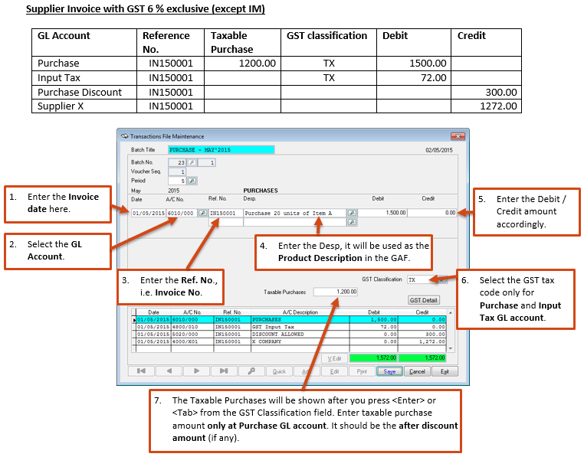
Part 2 | Verify Entries via Transaction File Maintenance
Notes:
To enter a supplier invoice with GST 6% exclusive.
Make sure you entered the supplier invoice number in the reference number field
Only enter tax code in the Purchase GL and GST Input tax GL
Enter the taxable purchase amount at the Purchase GL
Please note that if the Purchase GL amount is at Debit side, then the taxable purchase amount must be positive; if the Purchase GL account is at Credit side (assuming you are entering a purchase debit note) then the taxable purchase amount must be negative.
The rule of thumb, whether to enter a positive or negative as the taxable amount, just follow
If Debit → positive
If Credit → negative
Same applies to sales transactions

Slide 14
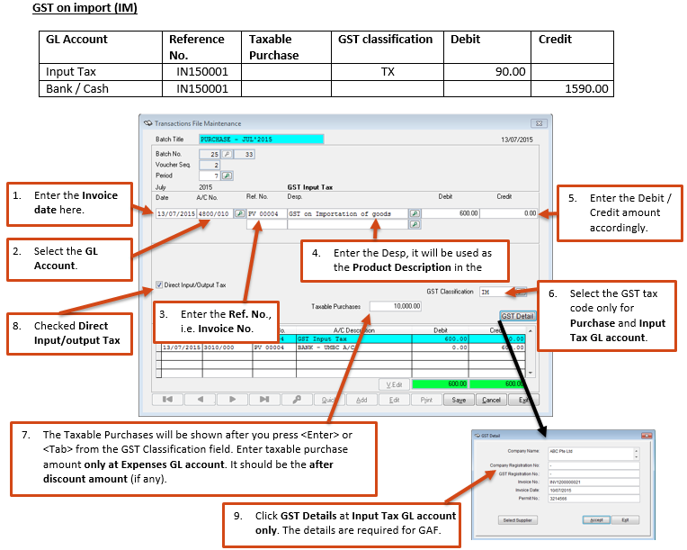
Part 2 | Verify Entries via Transaction File Maintenance
Notes:
The next example that I am showing you now is a journal entry without Creditor GL involved.
For example, GST on importation of goods, Deemed supply on free gift etc.
The way to enter journal entry is almost the same as the entries I showed to you in the previous slide. The only differences are
The taxable amount is entered at the Tax GL account.
You also need to click on the [GST details] at the Tax GL account and fill in the invoice details. These information is needed for GAF.

Slide 15
Part 2 | Verify Commonly made mistakes
Refer to knowledge.sage.my for tips on how to correct your transactions.
GST-03, GST Report, GAF - FAQ
Notes:
In the knowledge.sage.my, we also have articles on tip & tricks on how to correct your transactions. Look for the article entitled GST-03, GST Report, GAF – FAQ
Let me show you some examples of commonly made mistakes.

Slide 16
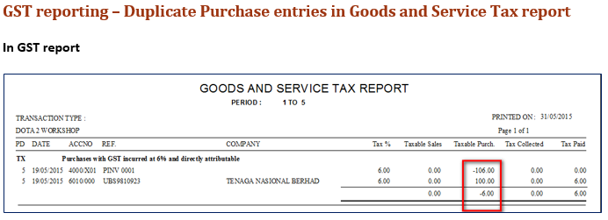
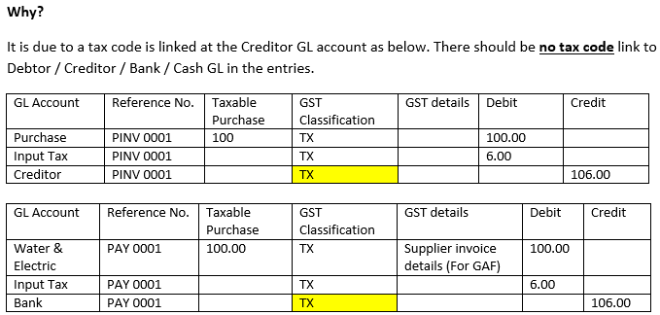
Part 2 | Verify Commonly made mistakes
Notes:
The supplier invoice entry showed 2 times in the tax report.
Why ?
It is due to tax code is being entered at the Creditor GL account.
At this point, you may be wondering how to search for those entry lines to remove the tax code 1 by 1. Don’t worry, we have a shortcut way to clean up the entries.

Slide 17
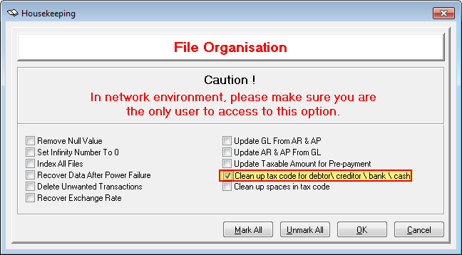
Part 2 | Verify Commonly made mistakes
Go to Housekeeping > File Organisation
Notes:
Go to Housekeeping > File Organisation, select the [clean up tax code for debtor / creditor / bank / cash] option, and click OK.
System will search and remove the tax code in all debtor / creditor / bank / cash GL found in the journal entries.

Slide 18
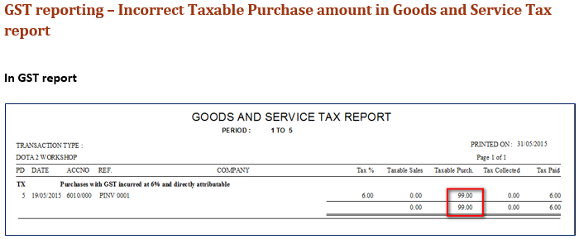
Part 2 | Verify Commonly made mistakes
Notes:
2nd example, the taxable amount shown in the tax report is incorrect.
Why ?
It may be due to taxable amount entered is incorrect.
To search for the entry, go to print ledger or view ledge, select the GL account shown in the tax report and generate the ledger report.

Slide 19
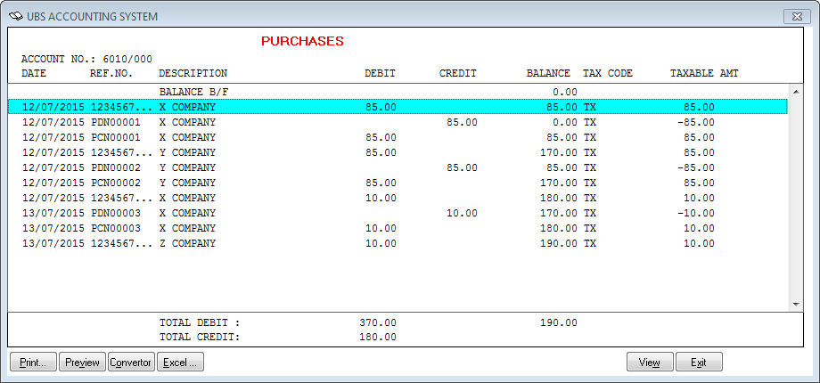
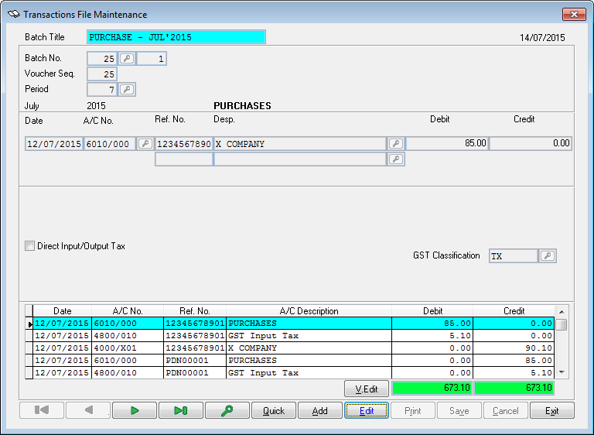
Part 2 | Verify Commonly made mistakes
Notes:
When found the transaction in the GL ledger, double click on it, the Transaction File Maintenance screen will be shown. You can now rectify the entries.

Slide 20
Part 2 | Verify Consistency Upgrade Program
Housekeeping > Consistency Upgrade Program
Objective
To fix inconsistent transactions as below :
Discount amount missing from cash sales entries and caused double entries unbalance.
Missing sales/purchase line during posting for the transaction keyed in before GST ON and Post to Accounting after GST ON.
Failed to group transaction tax line at Post to Accounting when GL account is mapped at Tax Code Maintenance.
Tax code changed to ‘ZR’ after posting to accounting
Incorrect taxable amount due to discount
Duplication found in the posted transactions
Notes:
Sometimes, you may found that the transactions posted to Accounting are incorrect.
In Sage UBS, we have a tool to help you to rectify those transactions.
Go to Housekeeping > Consistency update program
This tool will help you to correct some known issues in the data as listed in here.

Slide 21
Part 2 | Verify Tax code for Debit Note & Credit Note
Misconception
“AJP” is for Purchase entry
“AJS” is for Sales entry
Notes:
When you are checking through the GST-03, you found that the tax amount is shown at 5 (b) / 6 (b), but the taxable amount is not shown at 5 (a) / 6 (a).
This issue usually happened to Credit note & Debit note transactions using the “AJP” and “AJS” tax code.
By right, when issue Credit note & Debit note, you should use the same tax code as in the invoice.
Yes, in the older version of guideline from JKDM, it did mention that to use “AJP” and “AJS” for Credit note & Debit note. But if you check the latest guideline from JKDM, it explained that “AJP” and “AJS” in meant for Input tax / Output tax adjustment entries such as bad debt relief and bad debt recovered. And it also specifically mention that the amoount is to be shown in 5(b) / 6 (b) only.

Slide 22
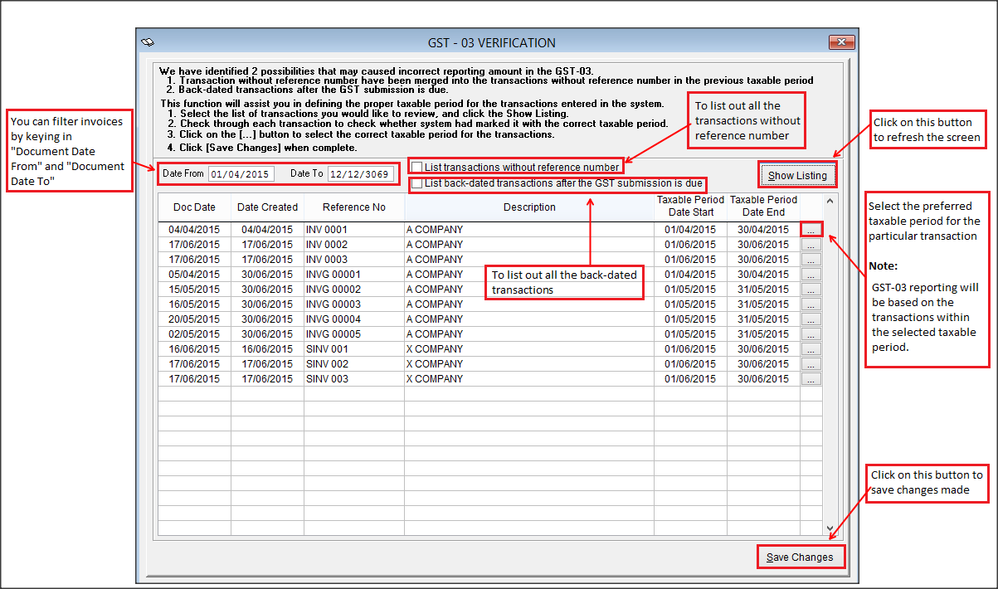
Part 2 | Verify Out of period transactions
Housekeeping > GST-03 verification
Notes:
Sometimes, especially supplier invoices dated at the end of the month, we only receive it at the next month. For example, a supplier invoice dated June, but only receive it on July.
So, it is your decision, whether you want this supplier invoice in June GST submission or July GST submission.
When you enter the supplier invoice journal entry, by default, system will place it under June taxable period. If you would like this supplier invoice to be report in July GST submission, then go to Housekeeping > GST-03 verification, click on [Show listing] for system to populate the transactions. Look for the supplier invoice, and change the taxable period to July.

Slide 23
GST-03 Submission Guideline

Part 1 | Setup

Part 2 | Verify

Part 3 | Finalize
Notes:
After we have checked and verify that all the 3 reports are tally, and we are ready to finalize the GST-03.

Slide 24
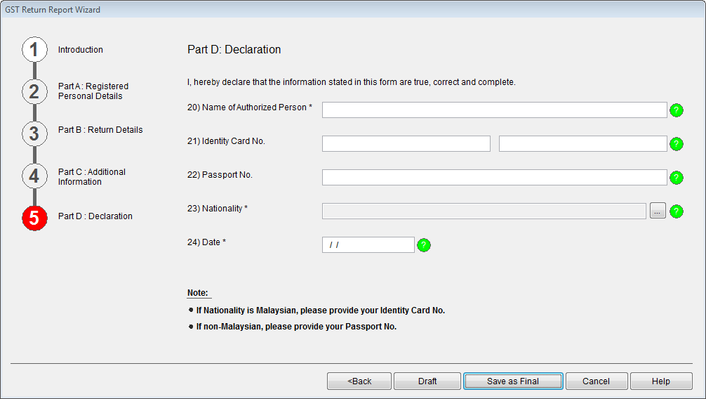
Part 3 | Finalize GST-03 – Save as Final
Dt GST Output tax
Cr GST Control
Dt GST Control
Cr GST Input tax
Notes:
Generate the GST-03 again, click [Save as Final].
For Sage 50, the journal entries will be generated automatically.
For Sage UBS, you will need to enter the journal entries manually for now, we will automate it in the coming release.
Some of you may be wondering now, what is these journal entries all about.
Let me further explain in the next slide.

Slide 25
Part 3 | Finalize GST-03 – Save as Final
5 b) 7920.00 6 b) 4975.47
When Finalize GST-03
Dt GST Output tax 7920.00
Cr GST Control 7920.00
Dt GST Control 4975.47
Cr GST Input tax 4975.47
Difference 2944.53 is the GST amount payable
When made payment to JKDM
Dt GST Control 2944.53
Cr Bank/Cash 2944.53
Notes:
We will debit the GST Output tax GL and credit into the GST control account; credit the GST input tax GL and debit into the GST control account.
With this, both the GST Output tax & GST Input tax GL are being zerorized.
The balance in the GST Control GL is the GST payable or GST claimable amount.
In this example, it is GST payable.
When you make payment to JKDM, you can enter a general payment entry against the GST control account.

Slide 26
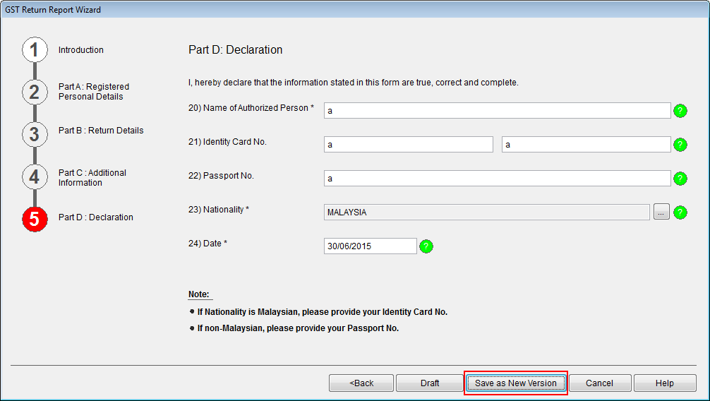
Part 3 | Finalize GST-03 – Versioning
Notes:
Sometimes, after GST submission, we discovered that we have made some mistakes in the submission and would like to rectify it. According to JKDM, we are allowed to re-submit the GST return if we discover any mistake made and quickly rectify it before the GST due date.
To do so, after you have made corrections in the transaction entries, select the respective GST Return, click on the [Edit] button, go through the GST Return wizard step by step. The amount in the GST return is being refreshed to obtained the updated data. At the end of the process, click [Save as New Version].

Slide 27
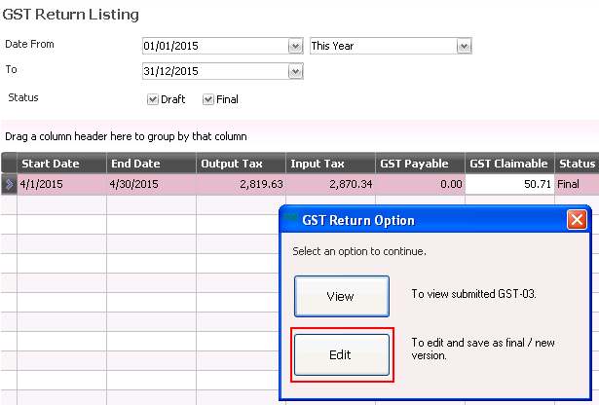
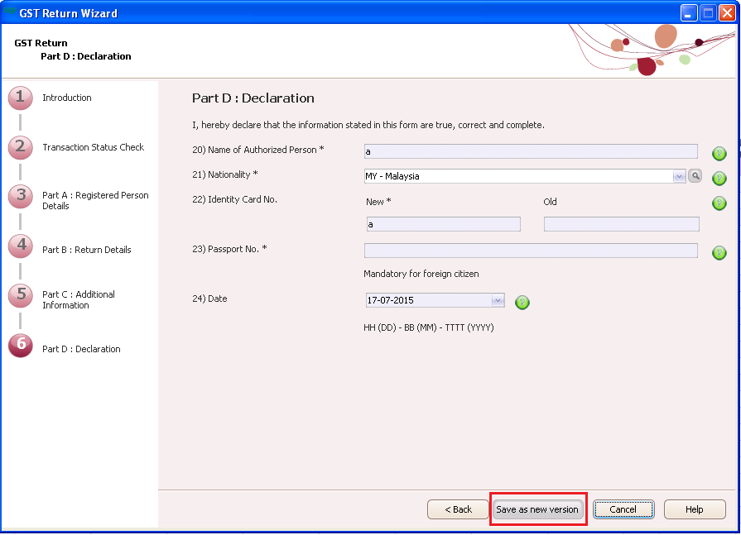
Part 3 | Finalize GST-03 – Versioning

Slide 28
GST-03 Submission Guideline

Part 1 | Setup

Part 2 | Verify

Part 3 | Finalize

Part 4 | Submit
Notes:
The last step, is to submit the GST return to JKDM.
There are 2 ways to submit the GST return, online or manual.

Slide 29
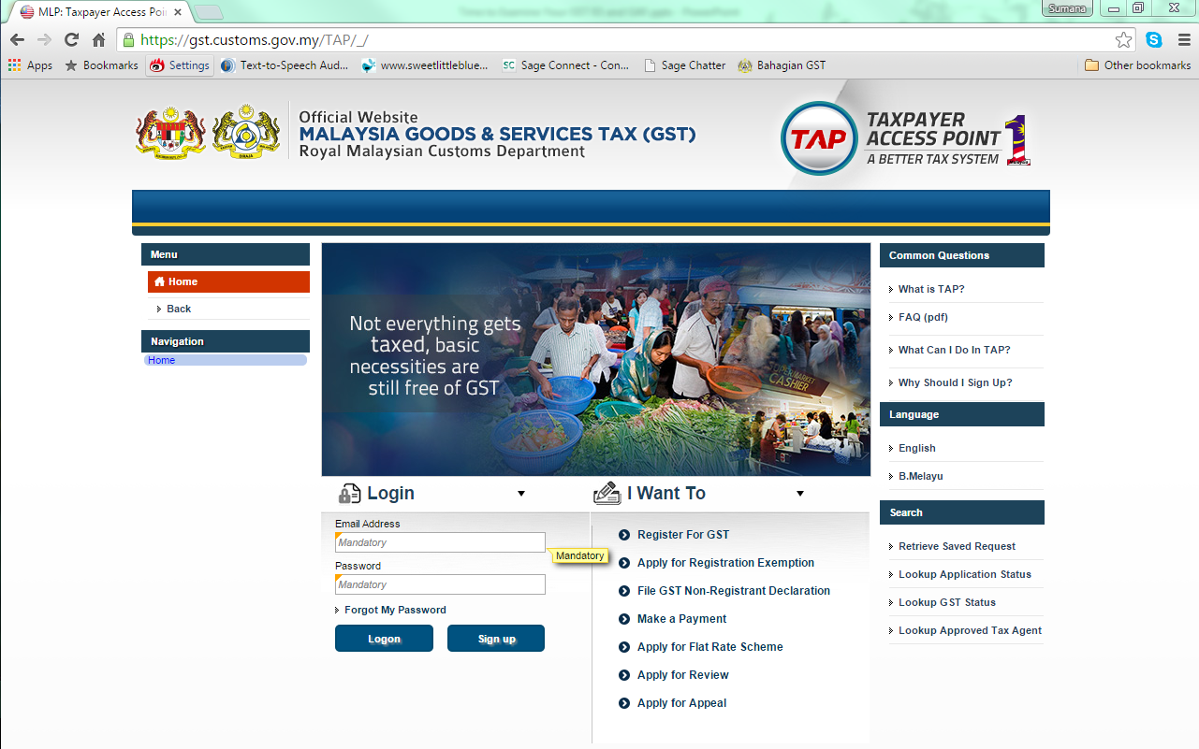
Part 4 | Submit Generate TAP and upload
Notes:
For online submission, first, generate the TAP file from the system.
Next, login to the Taxpayer Access Point via gst.customs.gov.my/TAP
Upload the TAP file.

Slide 30
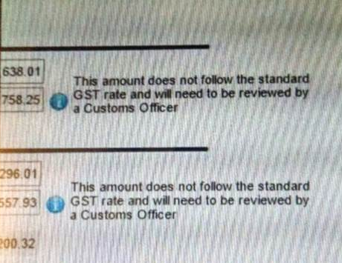
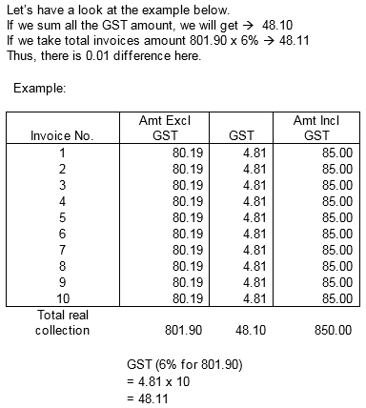
Part 4 | Submit Generate TAP and upload
Notes:
After you have uploaded the TAP file, the system will do a preliminary checking on the amount uploaded by multiplying the taxable amount with 6% to obtain the tax amount and compare.
This warning message is shown if there is any difference found. Please do not panic.
We have checked with JKDM and JKDM understands that most of the time, especially for purchase entries, there may be few cents difference due to the rounding calculation may be varied for different billing system.
Please proceed with the submission if you know the amount submitted is correct.

Slide 31
Part 4 | Submit Manual Submission – Important notice from JKDM
Notes:
This is an official email from GST unit of Jabatan Kastam Diraja Malaysia to all software vendors.
Refer to point (4) in the email, if you would like to do your GST return submission manually, you must use GST-03 pdf form downloaded from gst.customs.gov.my
We have contacted the GST unit of Jabatan Kastam Diraja Malaysia, and got the confirmation that a guideline for GST-03 form format will be released in near future, so that all software vendors will be able to standardize the GST-03 form in the accounting system.

Slide 33
Q & A
Q1 Not many people know new UBS can set With Purchase Tax,
Sales Tax & with GST, then the user can key-in GST
transaction with a safer method, I have customers come to
me with their data to check, a lot of the amount they key-in
doesn’t equivalent to 6%. -.-.

Slide 34
Q & A
To enable GST in the system, follow this simple guide:
Accounting System
Country Setting
Field name | Description and Input Requirement
Select Country | Make sure ‘MY” is selected so that system will apply Malaysia legislation control.
With Purchase Tax | Make sure it is selected so that the [Purchase Tax] field will be enabled in the system.
With Sales Tax | Make sure it is selected so that the [Sales Tax] field will be enabled in the system.
With GST | Make sure it is selected so that some GST function will be enabled in the system.

Slide 35
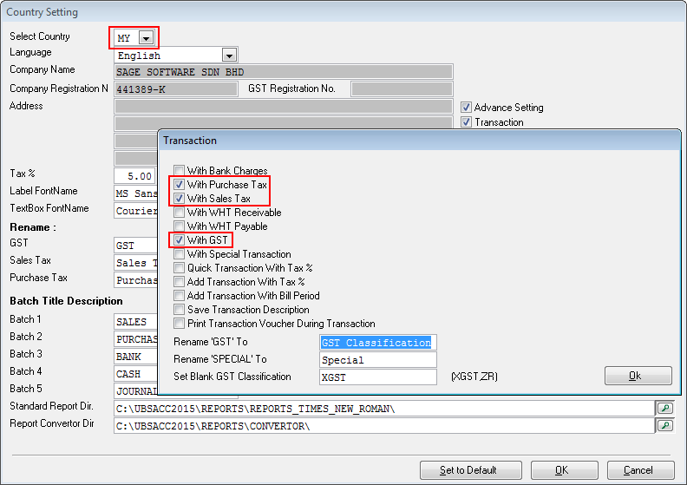

Slide 36
Q & A
Q2) Not many people uses Payment - Sundry Expenses function
too... as they don’t know got such method.
Sundry expenses was incorporated before TFM was open up
for GST entries. It was provided to allow user to enter
expenses without the need to maintain supplier master.
Now, user has the flexibility of entering sundry expenses via
Sundry Expenses option or via TFM which they are very
familiar with.

Slide 37
Q & A
To use Sundry Expenses option, user must first do the GL account mapping as below:
SageUBS - Accounting → General → Miscellaneous File → Tax Code Maintenance

Slide 38
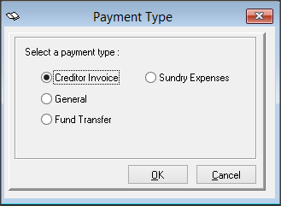
Q & A
After that, access Sundry Expenses option via
SageUBS - Accounting → Transaction → Payment → Sundry Expenses

Slide 39
Q & A
If user want to key in by using TFM, please refer to the link below on how to key in the transaction.
http://knowledge.sage.my/index.php?/article/AA-05617/0/Sage-UBS-Transaction-File-Maintenance.html

Slide 40
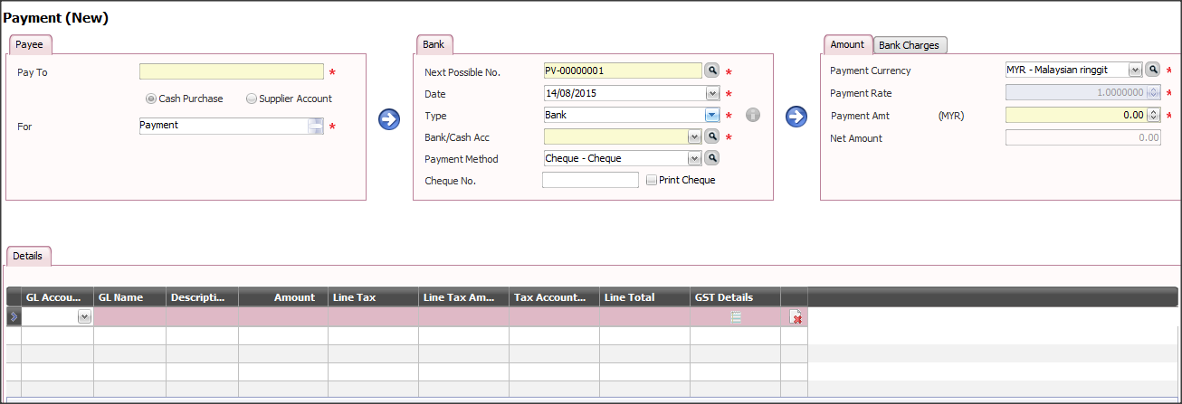
Q & A
Sage50 - Accounting → Payment → General

Slide 41
Q & A
Q3) Capital goods acquired is a topic not many People know.
Fixed assets purchased solely for business usage fulfill the criteria of Capital Goods. You will be required to maintain capital goods via Periodic → Capital Goods → Maintain Capital Goods function so that it can be recorded correctly om Item #16 of the GST-03 Return
Note that Car purchased for director’s usage is not capital goods as it does not contribute to the business running / operations.

Slide 42
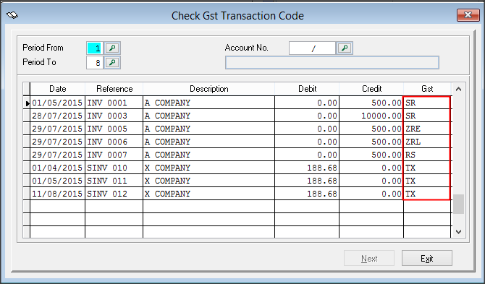
Q & A
Q4) How to change tax code if use wrong tax code.
Please advise user go to Accounting → Reports → Goods And Service Tax → Check GST Transaction Code
*Please note that changes will apply ONLY at Accounting but I&B will remain the same. The proper way of adjustment for POSTED bills should be Credit Note or Debit Note.

Slide 43
Q & A
Q5) Taxable Purchase need key-in for all tax code?
Please advise user to key in taxable amount in order to let system capture the correct taxable amount and show in GST report. Example as below

Slide 44
Q & A

Slide 45
Q & A
Q6) GST Details at TFM Compulsory to key-in?
Please refer to the scenario below:
Scenario1: Transaction with Supplier/Customer Info
Based on this scenario, GST details is optional for the User to key in. This is because system will get the creditor information from the transaction.
GL Account | Reference No. | Taxable Purchase | GST Classification | GST details | Debit | Credit
Purchase | PINV 0001 | 100.00 | TX |  | 100.00
Input Tax |  |  | TX |  | 6.00
Creditor |  |  |  |  |  | 106.00

Slide 46
Q & A
Scenario2: Transaction without Supplier/Customer Info OR
Sundry Expenses
Based on this scenario, use should key in the GST Detail since there is no creditor information in this transaction.
GL Account | Reference No. | Taxable Purchase | GST Classification | GST details | Debit | Credit
Purchase | PINV 0001 | 100.00 | TX |  | 100.00
Input Tax |  |  | TX |  | 6.00
Bank |  |  |  |  |  | 106.00

Slide 47
Q & A
Q7) If late receive supplier invoice a few months later, which
date should we key-in at? follow document date? or Key-in
Date?
Either way, because this kind of scenario can be handled by using GST03 verification (SageUBS only)
Example:
Current taxable period = 01/07/2015 – 31/07/2015
Receiving Supplier Invoice which dated 12/05/2015 at 14/08/2015
User can issue the Supplier Invoice with the date 12/05/2015 or 14/08/2015

Slide 48
Q & A
iv) Once complete, go to Accounting → Housekeeping → GST-03
verification, change the taxable period to current taxable period
(if user key in the Supplier Invoice date = 12/05/2015)
For more information, please refer to
http://knowledge.sage.my/index.php?/article/AA-07820/0/Taxable-Period-and-GST-03-Verification.html

Slide 49
Q & A
Q8) I found out that not many user know Account & Billing are separated program, so they will always thought backup at account is enough, or closing at account is okay already.
- Please advise user do for both Accounting and I&B since there are separated module.

Slide 50
Q & A
Q9 How to check if GST 5A/5B 6A/6B is key-in correctly & its equivalent to 6%?
Please advise user do a cross check between GST-03, Goods and Service Tax report and Ledger, make sure they are tally.
On how to key in correct transaction, please advise user refer to
http://knowledge.sage.my/index.php?/article/AA-05617/0/Sage-UBS-Transaction-File-Maintenance.html

Slide 51
Q & A
Q10) What should I do after submitted GST-03.
- Please refer to the attached slide (Slide 23 – Slide 27)

Slide 52
Time to Examine Your GST 03 and GAF
April 20, 2017
Thank You !

